Slide 1

CS-354 : MINOR PROJECT
Chatbot for
Mental Heathcare
Harshit Pachar
Devesh Jindal
Prathmesh Patil
200001027
200001020
200001061

Slide 2

INTRODUCTION
Chatbots have been used to replace humans at various tasks. However , there use in Mental Helath care has not been explored significantly
what is mental Health Chatbots
Working of chatBots
Need for mental Health Chatbots
Future of Mental health Chatbots
Our Progress
Conclusion
Presenting to you "SAARTHI"

Slide 3
What is Mental Healthcare Chatbot
Mental health care chatbots are computer programs designed to simulate conversations with users and offer support and guidance for mental health concerns.
Chatbots are typically programmed with natural language processing (NLP) algorithms, which allow them to recognize and respond to user input in a conversational manner.
Chatbots can be programmed to ask questions to assess a user's mental health status and provide support and advice based on their responses.
Some chatbots also use machine learning algorithms, which allow them to learn from user interactions and adapt their responses over time.

Slide 4
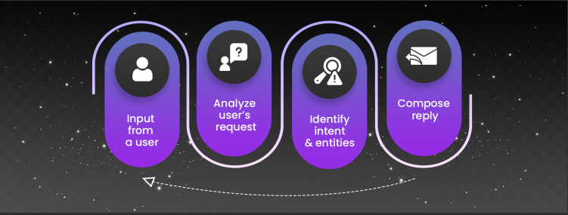
How mental healthcare chatbots work
Use existing conversations to understand the type of questions that humans typically tend to ask.
Pre-process the conversations by using existing technologies.
Undergo a training period and analyze the answers to the asked questions.
Improvise in answering the questions by using NLP and some machine learning algorithms.

Slide 5




TECH STACKS USED
Numpy
Pandas
NLTK
Tensorflow
Keras
LSTM
Credits

Slide 6
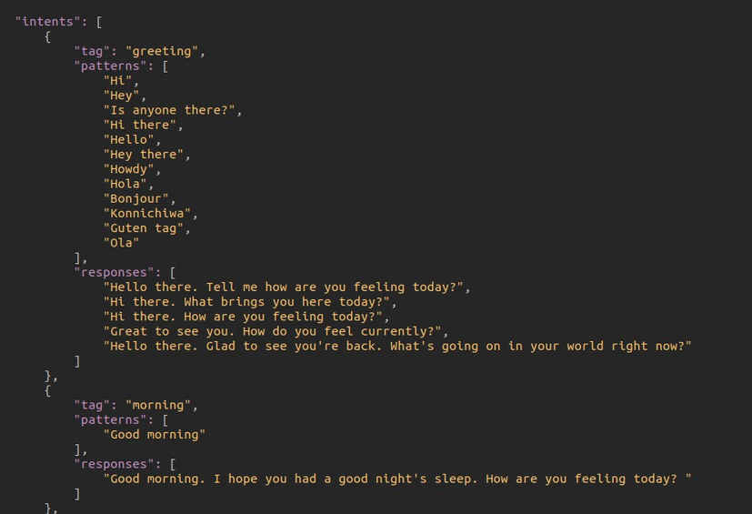
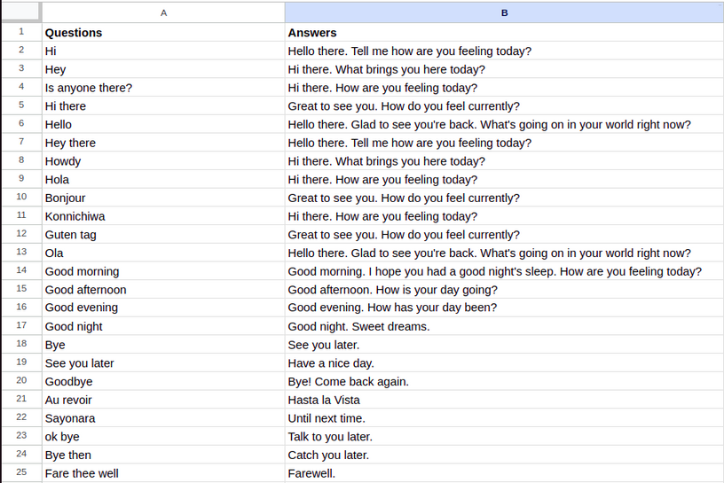
FORMAT OF THE DATA
Our 1st data is in the form of a .json file.
The structure of the file is in the form of 'tag', 'patterns', 'responses'.
'tag' specifies the category under which the questions fall.
'patterns'' contains the questions under a particular category that can be asked by the user to the chatbot.
'responses' contains the response the chatbot that the chatbot will give to the user for that question.
Our 2nd data is in the form of .csv file.
The length of this file is 4827.
In the .csv file we have 2 colums 'questions' and 'answers'
We take question as a input from the user, find the most similar question from the corpus and then return its corresponding answer.

Slide 7
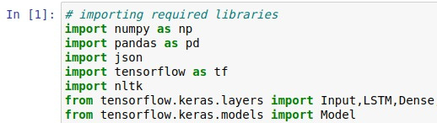
Importing the Libraries
Initially, we will import all the necessary libraries.
We need 'pandas' to create DataFrame and read the initial intents.json file and .csv file.
Then we must use 'TensorFlow' to implement our Neural Network model.
We will use the NLTK library to perform pre-processing on our data.

Slide 8
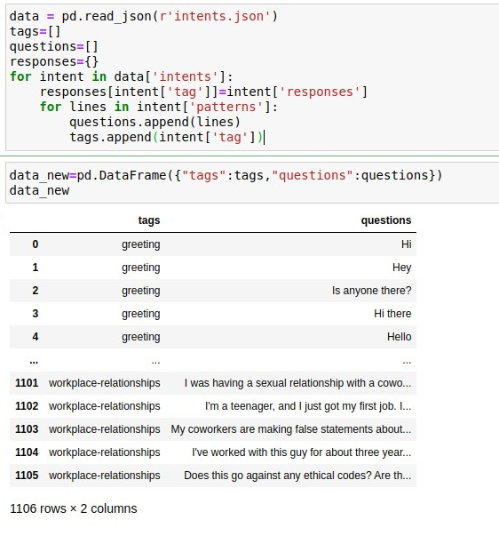
Converting JSON Data to pandas DataFrame
We need to convert the JSON data to pandas DataFrame so that we can work on it.
The working of our model is such that we are taking the input question from the user then we are predicting the tag for that input and will return any response from that tag.
So, we have taken only tag and questions in the dataframe, and we have taken responses in another array.

Slide 9
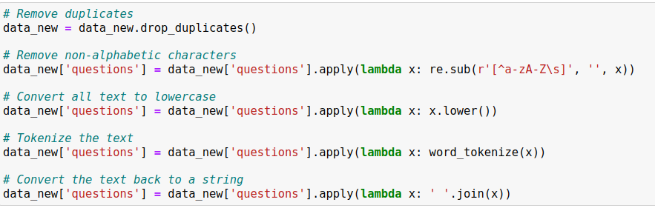
Pre-Processing of Data
We have to make our data clean before putting it into our model.
Firstly, we have written regex for removing the duplicate rows from our data.
Secondly, we have removed all the non-alphabetic characters.
Then we will convert the whole data to lowercase to make it easy for the model.
Then we will tokenize the text to replace sensitive data with non-sensitive substitutes without altering the type or length of data.
Finally we will convert the tokenized text back to a string to feed into the model.

Slide 10
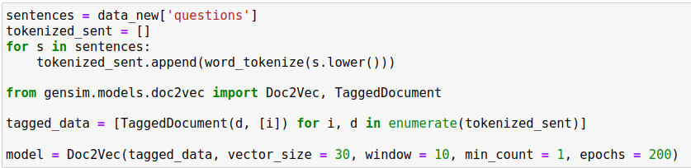
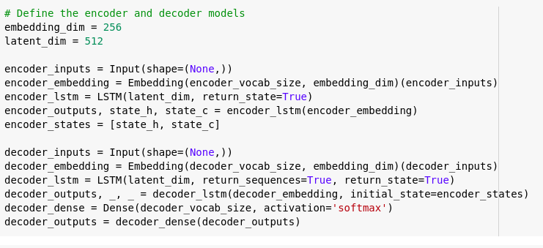
MODELS
We have tried 3 type of models:
Simple Neural Network
Doc2Vec Model
Seq2Seq Model

Slide 11
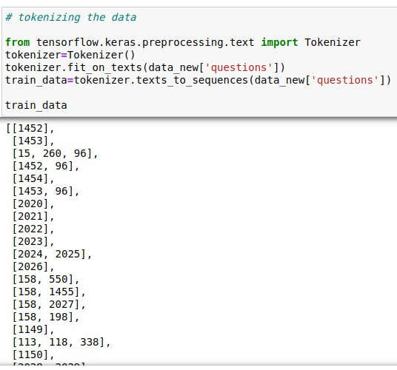
MODEL-1
Tokenizing the Data
'Tokenization' is the process of breaking down a text into individual words or tokens.
'fit_on_texts' is a method used to learn the vocabulary of a given text corpus. The method takes in a text corpus and learns the frequency distribution of the words in the corpus.
'texts_to_sequences' is a method used to convert a list of texts into a list of sequences of integers, where each integer represents a unique word in the text corpus.

Slide 12
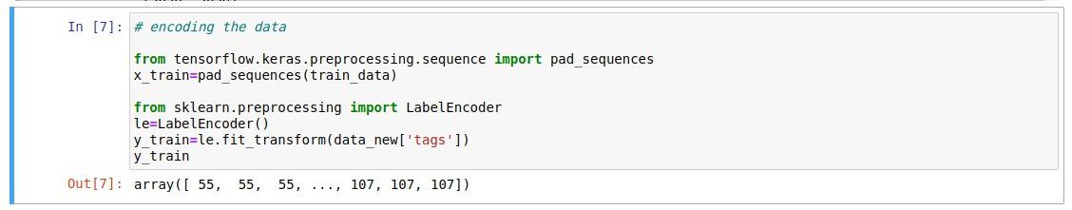
Encoding the Data
'Encoding ' the data means converting all the words in our corpus to vector of numbers.
'pad_sequences()' is a method used in natural language processing (NLP) to convert a list of sequences of different lengths into a matrix of fixed-length sequences.
LabelEncoder.fit_transform() is a method used to transform categorical data into numerical data that can be used as input to a machine learning model.

Slide 13
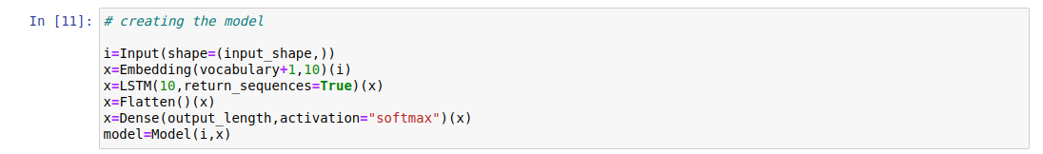
Creating Simple Neural Network Model
The first layer in this model is an input layer for the Keras model.
The second layer is an embedding layer that maps the input text sequence to a fixed-length vector representation.
The third layer is a recurrent layer using LSTM cells. We have used 10 LSTM usints in this layer.
The fourth layer is just flattening the output from LSTM layer means converting it to 1-D.
The fifth layer is just a simple dense layer of a neural network that gives us the final output using 'softmax' as the activation function.

Slide 14
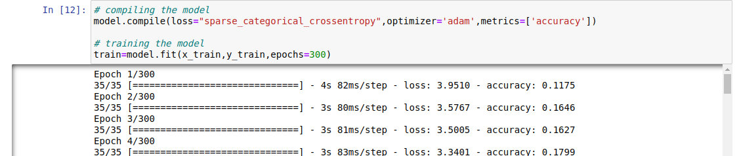
Compiling the model
The first line of code compiles the neural network model and sets the loss function, optimizer, and metrics that will be used to train the model. The metrics parameter specifies the evaluation metric to be used during training, which is set to 'accuracy'.
The second line of code trains the compiled model using the training data, x_train, and y_train. The epochs parameter specifies the number of iterations over the entire dataset to be performed during training, which is set to 300 in this case. The fit() method returns a History object which contains information about the training process, including the values of the specified metrics at each epoch.

Slide 15
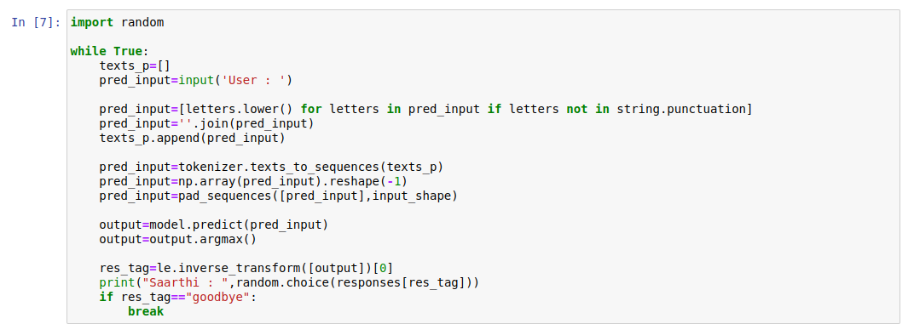
Predicting from the model
In this, we are taking the input string from the user and then pre-processing that string as done earlier by converting it into lowercase and removing punctuations.
Next, we tokenized the input string in the same manner as done earlier.
Then we predict the output for the user string using the model.
Our model is just matching the res_tag of the string and bringing the random response from the list of answers for that question.
If the tag is goodbye, then our model exits.

Slide 16
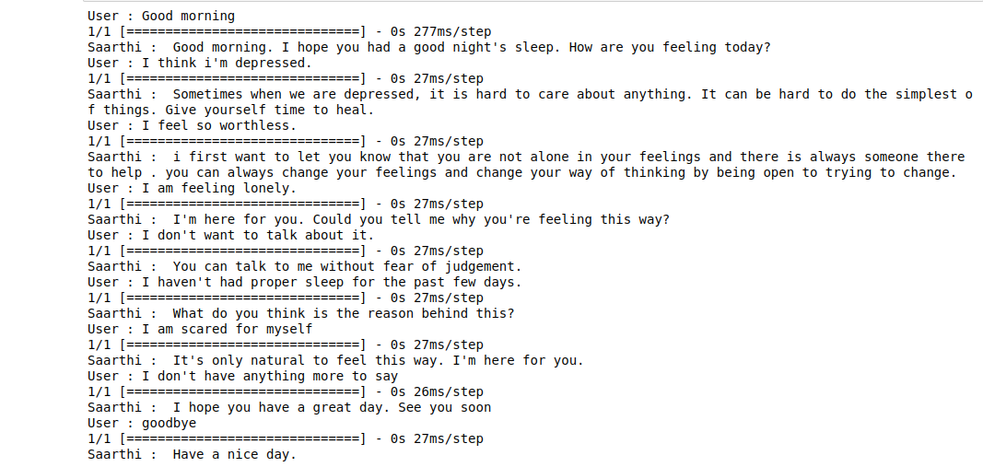
Sample conversation with chatbot using Model-1

Slide 17

MODEL-2
What is Doc2Vec?
Gensim is a python open source library that is used to convert documents to vectors. It is used to perform complex NLP tasks.
Doc2Vec is a model from the gensim library. It is more generalized form of word2vec.
Word2vec converts every word to a vector but, Doc2vec coverts every sentence(questions here) in our corpus to a vector rather than converting words to vectors.

Slide 18
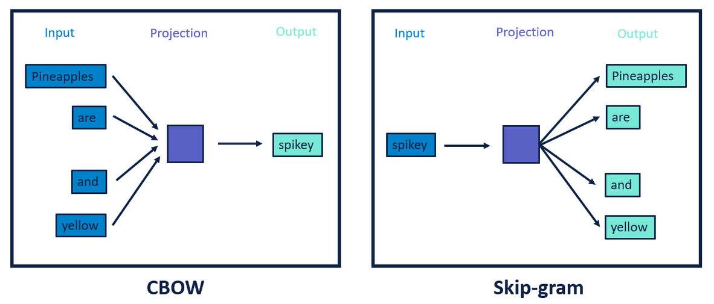
Why Doc2Vec?
Word2vec is a computationally effective way for converting words to multi-dimensional vectors.
Word2vec can rely on 2 models to make vectors, one is CBOW (Finding target word from context words) and other is Skip-gram (Finding context words using target word).
But problem with Word2vec is that it can be effective only when we want to find the most similar words and not for finding most similar sentences.
Here Doc2vec comes to rescue, Doc2vec converts whole sentence to a vector so we can find the most similar sentence to our input sentence easily.

Slide 19
Creating Doc2Vec Model
Initially we will tokenize each sentence in our corpus.
Then we need the tagged document for every sentence which we will generate by using the TaggedDocument() function.
The we will train our model by using vector size as 30, window as 10 and min_count as 1.
Parameters are:
'vector size' represents the size of the vector every question will be converted to.
'window' represents the maximum distance between the current and predicted words.
'min_count' represents the minimum frequency of the words below which they shall be ignored.

Slide 20
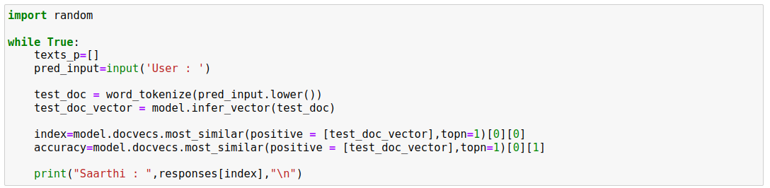
Predicting from the model
Firstly we will take the question as an input from the user.
Then we will tokenize that question and will convert it into vector using our pre-trained doc2vec model.
Then that vector will be compared to all the vectors we used to train the model, then our model will find the most similar vector to the input using the cosine similarity function.
Then we will return the answer corresponding to the most similar question.

Slide 21
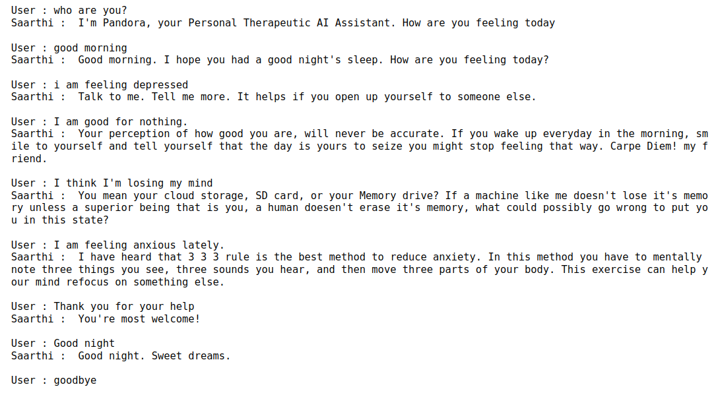
Sample conversation with chatbot using Model-2

Slide 22
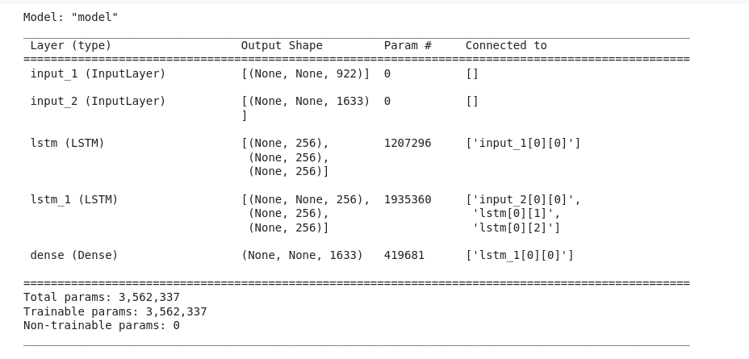
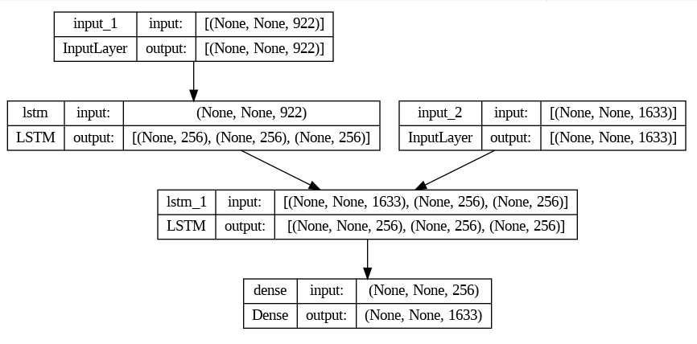
MODEL-3
Seq2Seq Model

Slide 23
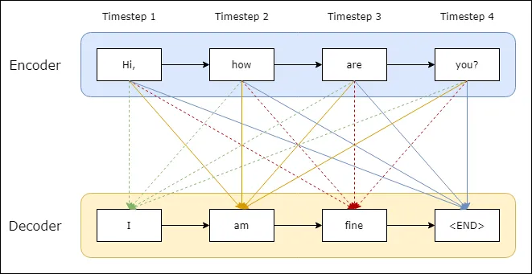
How Seq2Seq model works?
It predicts a word given in the user input and then each of the next words is predicted using the probability of likelihood of that word to occur. In building our chatbot we will use this approach for text generation given in the user input.
The encoder outputs a final state vector (memory) which becomes the initial state for the decoder. We use a method called teacher forcing to train the decoder which enables it to predict the following words in a target sequence given in the previous words.

Slide 24
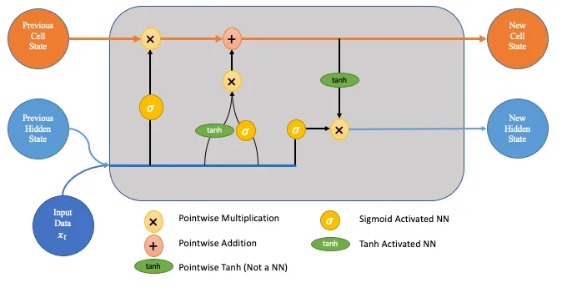
What is LSTM layer?
The first step in the process is the forget gate. It decides which pieces of the long-term memory should now be forgotten given the previous hidden state and the new data point in the sequence.
The next step involves the new memory network and the input gate. The goal of this step is to determine what new information should be added to the network's long-term memory (cell state), given the previous hidden state and new input data.
The final step, the output gate, decides the new hidden state. To decide this, we will use three things; the newly updated cell state, the previous hidden state, and the new input data.

Slide 25
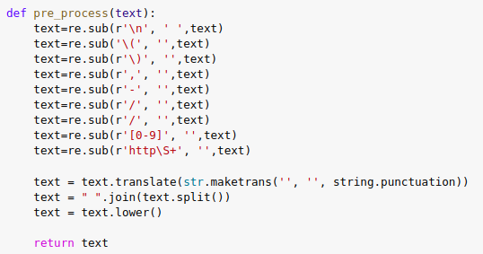
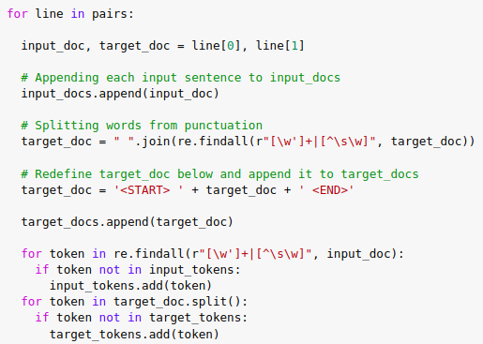
Data Pre-processing
We remove digits, unnecessary links, some brackets, and slashes from the left side code. Then we convert the text into lowercase.
By the right side code, we are removing punctuation from the text and adding start and end tokens for each answer text so that the model gets to know where the sentences started and where ended.

Slide 26
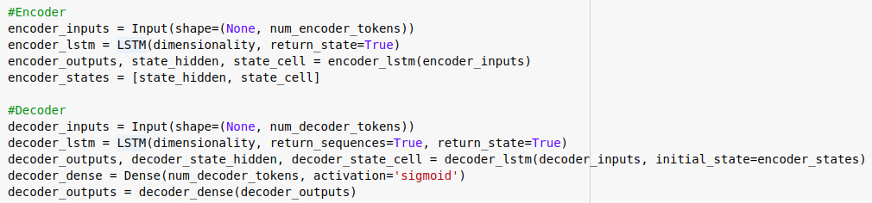
Creating the model
Encoder:
The encoder is responsible for processing the input sequence and encoding it into a fixed-length vector, often referred to as the "context vector".
It starts with an input layer that takes inputs from the sample.
Next, we create a recurrent layer using LSTM cells. This is the last layer for the encoder.
Decoder:
The decoder is usually a recurrent neural network (RNN) that generates one output element at a time, conditioned on the previous output elements and the context vector.
It also starts with an input layer which will receive inputs from Encoder.
Next, we have LSTM layer based on RNN. Its output will go to the Dense layer and will generate the final output.

Slide 27
Compiling the model
After creating the model we use 'Adam' optimizer and 'categorial_crossentropy' as a loss function and 'accuracy' as our evaluation metrics on validation data.
Sample weights are used to assign a weight to each training example in the dataset. The purpose of sample weighting is to give more importance to some samples than others, depending on their relevance to the learning task.
We used validation split as 0.1 means 10% of samples will be used for testing.
After all we saved our model by name "training_model".

Slide 28
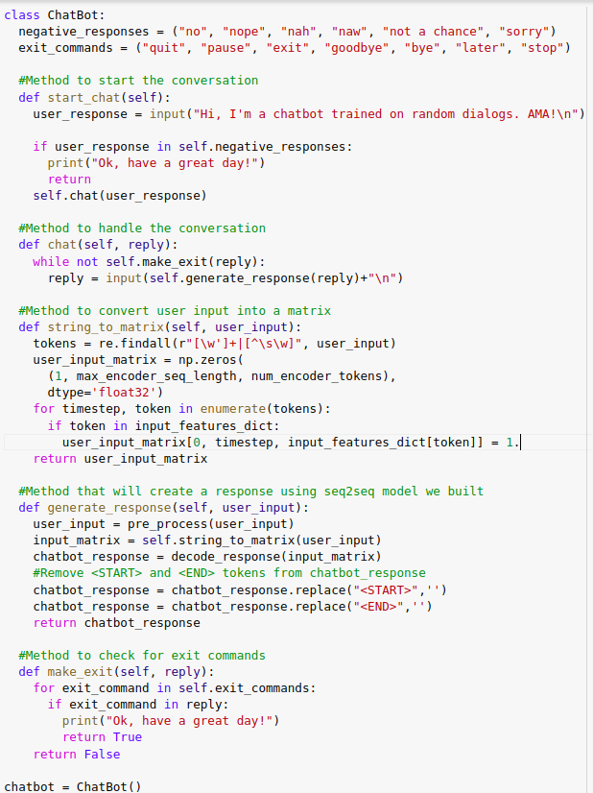
Predicting from the model
After training the model we have to predict user inputs.
For this, first, take inputs from the user then preprocess the input text and tokenized it.
After tokenization, pass it to the encoder and after processing the encoder will output its results.
Next, we have a decoder and it will generate the final output after taking inputs from the encoder.
We also have some exit commands which help the user to stop interacting from chatbot.

Slide 29
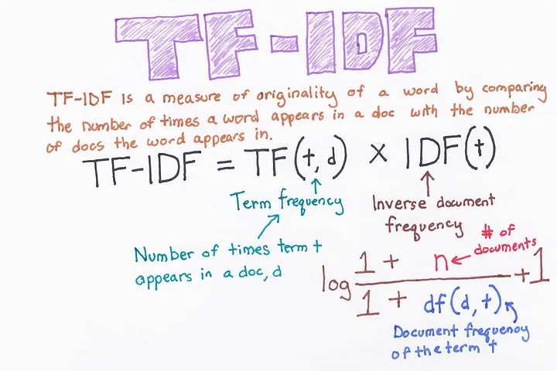
Tf-Idf Vectorizer
Vectorization is the process of transforming a scalar operation acting on individual data elements (Single Instruction Single Data—SISD) to an operation where a single instruction operates concurrently on multiple data elements (SIMD).
TF-IDF is an abbreviation for Term Frequency Inverse Document Frequency. This is very common algorithm to transform text into a meaningful representation of numbers which is used to fit machine algorithm for prediction.

Slide 30
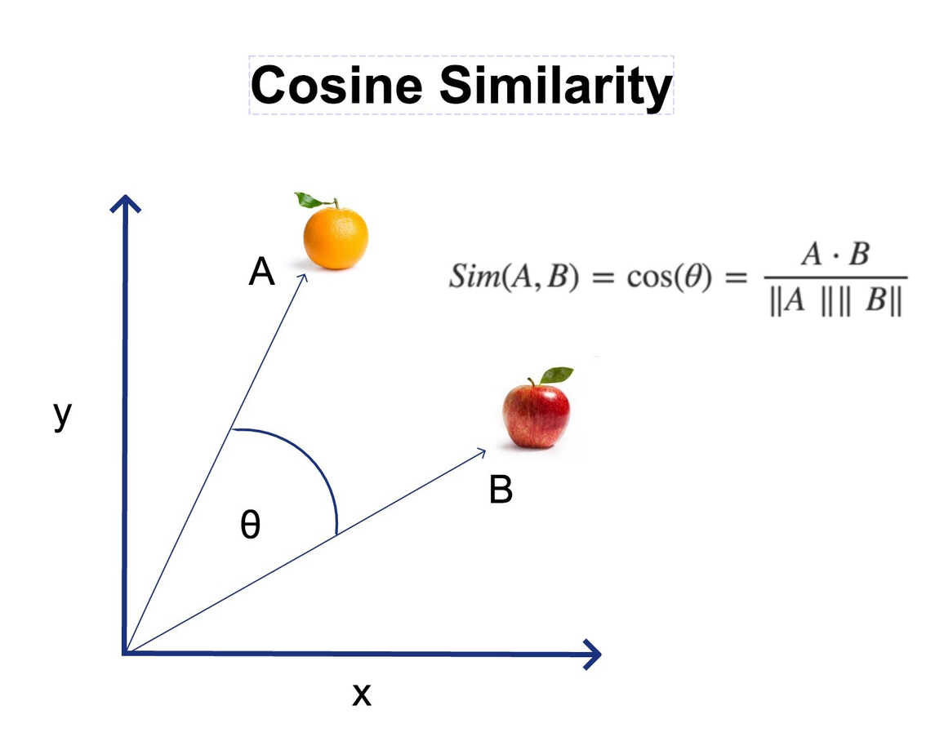
Cosine Similarity
Cosine similarity is a metric used to measure how similar the documents are irrespective of their size. Mathematically, it measures the cosine of the angle between two vectors projected in a multi-dimensional space.
The cosine similarity is advantageous because even if the two similar documents are far apart by the Euclidean distance (due to the size of the document), chances are they may still be oriented closer together. The smaller the angle, higher the cosine similarity.

Slide 31
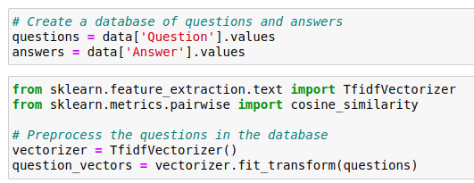
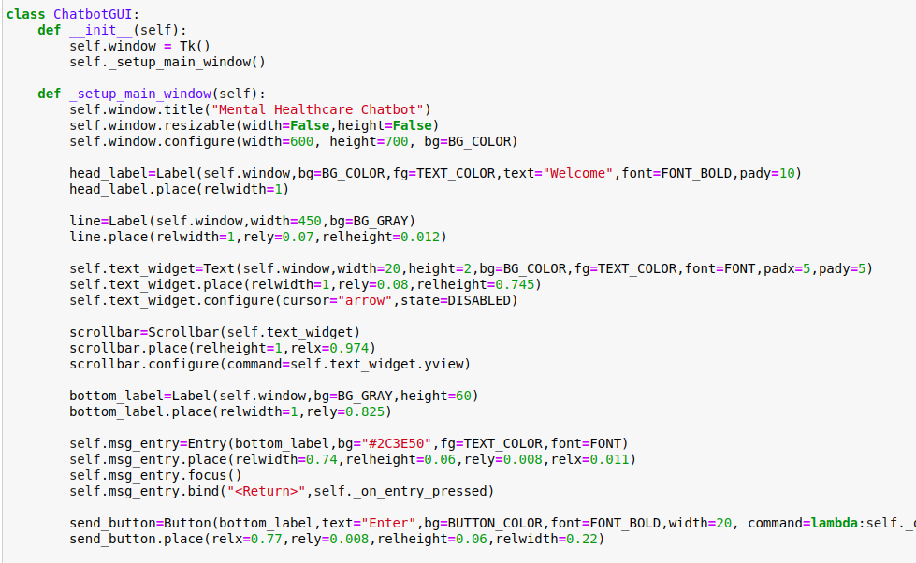
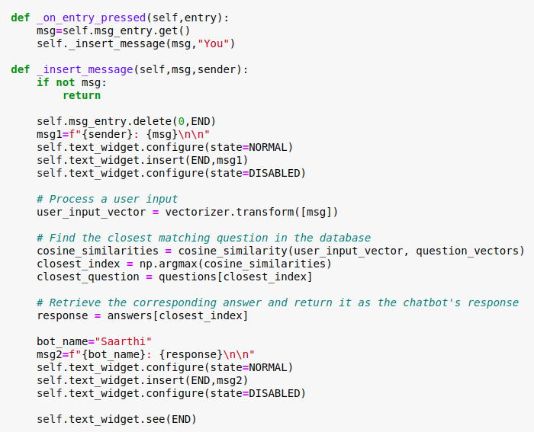
Putting Everything Together
Presenting to you "SAARTHI"

Slide 32
References
https://www.mdpi.com/2076-3417/10/7/2221
https://www.researchgate.net/publication/336054143_An_overview_of_the_features_of_chatbots_in_mental_health_A_scoping_review
https://papers.ssrn.com/sol3/papers.cfm?abstract_id=3362123
https://soar.suny.edu/handle/20.500.12648/1594
https://towardsdatascience.com/day-1-2-attention-seq2seq-models-65df3f49e263
https://towardsdatascience.com/lstm-networks-a-detailed-explanation-8fae6aefc7f9

Slide 33
FutureWork
We have used 3 different models for making this chatbot and we will finally use that model that gives us the best accuracy on our predictions.
There are some flaws in some models that we have used now in predicting the correct output. First, we will focus on it.
Like our model-3, it is going out of RAM on large data. This model needs to be upgraded by adding a few more layers for better functioning with LSTM.
These models only work on a fewer amount of data means the chatbot can't generate its own words or sentences, so this will be our future task.
We will make the chatbot learn from human conversations after the initial deployment.

Slide 34


